Slide 1

SenCluSum AI
Dr. Salvador Vento
Turning reviews into actionable insights through AI-powered sentiment clustering and summarization.

Slide 2
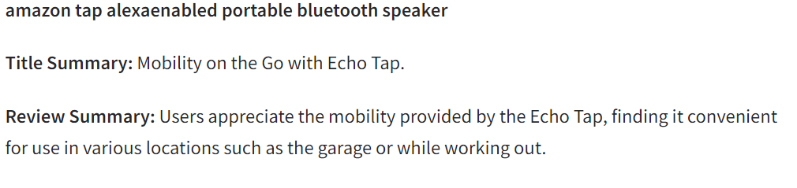
SCS Tapping into the untapped potential of reviews
Natural language analysis
Accurate prediction of review sentiment (97%)
Efficient categorization
Get insights into none-traditional categories
GenAI efficiently summarizing thousands of reviews into one concise summary.
Turning reviews into actionable insights through AI-powered sentiment clustering and summarization.

Slide 3
Live demo time!
Turning reviews into actionable insights through AI-powered sentiment clustering and summarization.

Slide 4
SCS Tapping into the untapped potential of reviews
Problem
Thousands of products and reviews
Inefficient manual analysis
Bot reviews & poor language
Solution
Automated evaluation of review sentiment.
Automated clustering(category)
GenAI analysis of products
Finds top products for category
Provides insights on why users like or dislike the products.
Why?
Find out what works and what does not
Learn about your users to better target them ( sales & marketing)
Addressing a multi-billion dollar market for product insights and review analytics
Turning reviews into actionable insights through AI-powered sentiment clustering and summarization.

Slide 5
Efficient pipeline from simple to complex
Raw data
Sentiment analysis (fine-tunned BERT)
Cluster creation (ML & SBERT)
Summarization (Mistral)
Pre-process
Top products summaries
Dataset: small Amazon product reviews dataset ( reviews from 2016-2018)
Pre-processing: Merge files→ eliminate duplicates →eliminate irrelevant columns →check for NaN
Turning reviews into actionable insights through AI-powered sentiment clustering and summarization.

Slide 6
Fine-tunned BERT Simple, Light and Fast sentiment analysis
Star ratings are flawed
Users fail to understand them and their reviews don’t match the rating.
Implementation of simple transformer models with fine tunning for a non-resource intensive solution
Tested transofrmers models: DeBERTA, RoBERTA, DistilBERT
More resource intensive than BERT
Equal or worse results after fine-tunning.
BERT
Simple and effective after iterating over hyperparameters to find optimal combination
Turning reviews into actionable insights through AI-powered sentiment clustering and summarization.

Slide 7
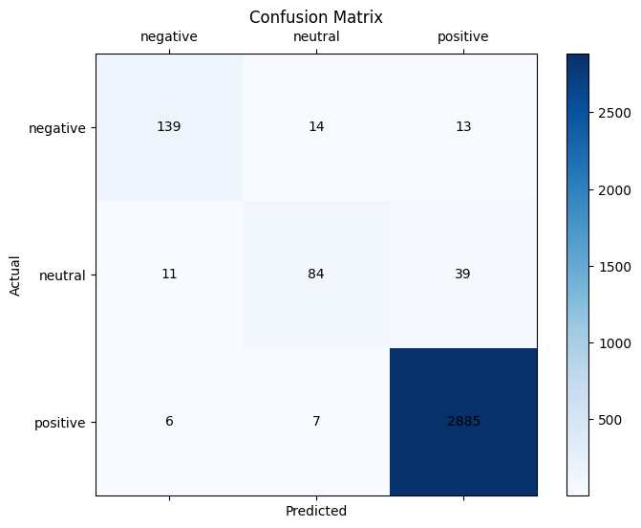
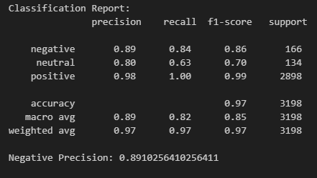
Fine-tunned BERT Simple, Light and Fast sentiment analysis
Star ratings are flawed
Users fail to understand them and their reviews don’t match the rating.
Challenge: Biased dataset
Solution:
Weights to balance dataset
Iteration over combinations of diverse learning rates and batch sizes
Evaluating on negative review accuracy to find optimal hyperparameters
Turning reviews into actionable insights through AI-powered sentiment clustering and summarization.

Slide 8
Harnessing the power of ML & transformers
Traditional categorization is too broad for todays offering
Lack of insights into true competitors
Untapped markets to be discovered
Cross-selling opportunities
Combination of ML & SBERT → Winning team
Combination of Tf-IDF & SBERT embeddings to cluster with K-means
Room for improvement
Retrieving product descriptions would bring key information for more accurate categorization and sub categorization
Abstract titles with buzzwords provide little insight into the product sometimes
Turning reviews into actionable insights through AI-powered sentiment clustering and summarization.

Slide 9
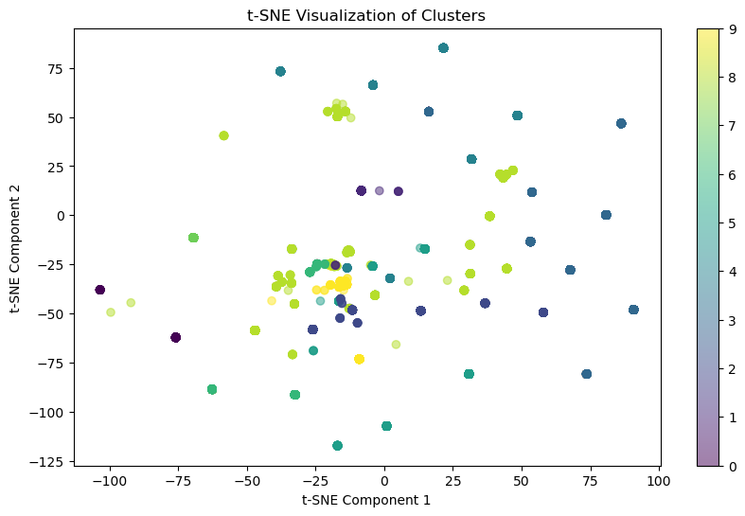
Clustering – a work in progress
Iteration over cluster number from 2 to 13 yields the best silhouette score at 10 clusters
Silhouette Score for 10 clusters: 0.7457376718521118
Buzzwords, and SEO oriented titles prove a challenge for clustering
Turning reviews into actionable insights through AI-powered sentiment clustering and summarization.

Slide 10
Leveraging pre-trained Mistral
Extracting key insights from thousands of reviews is humanly impossible without algorithms. But using reviews to extract both pros, cons, how customers feel, type of customers and other insights from the natural language is simply impossible… or is it?
Prompt engineering to leverage the power of GenAI
Pros:
Reduced training time
Significantly cheaper to fine-tune and use
Turning reviews into actionable insights through AI-powered sentiment clustering and summarization.

Slide 11
Prompt engineering on Mistral Key Insights and Final Evaluation Results
Summary and title quality assessments:
Lexical Diversity: 0.9092463169237852
Readability: 56.58599999999999
Length Consistency (Variance): 97.19749999999999
Average Sentiment Score: 0.39620464852607706
Uniqueness Score: 1.0
Average Noun-to-Verb Ratio: 3.2185119047619053
Turning reviews into actionable insights through AI-powered sentiment clustering and summarization.
Notes:
Lexical Diversity (0.90):
This metric is calculated as the ratio of unique words to the total number of words. A high lexical diversity (closer to 1) suggests that the text uses a wide variety of words, which generally indicates richness and lack of redundancy. In this case, 0.90 indicates that your summaries and titles use a diverse vocabulary and avoid repeating the same words too often.
Readability (56.59):
Readability scores, such as Flesch Reading Ease, gauge how easy the text is to read. A score of 56.59 falls within the "fairly difficult" range, meaning the content is moderately challenging to read. For general audiences, a higher readability score (closer to 70-80) is often preferred. However, this can vary depending on the context and the intended audience's reading level.
Length Consistency (Variance: 97.20):
Variance in length reflects the consistency of the summary lengths. A high variance suggests more fluctuation in summary lengths, which might indicate that the model isn't generating outputs of uniform length. Depending on the context, you may want a lower variance for more consistency, particularly if summaries need to be concise and standardized.
Average Sentiment Score (0.39):
Sentiment scores typically range from -1 (very negative) to +1 (very positive). A score of 0.39 indicates a slightly positive sentiment in the summaries on average. This score shows that the summaries are generally positive, although they are not overly enthusiastic. This could be beneficial if the aim is to convey a balanced perspective.
Uniqueness Score (1.0):
This score suggests that all generated summaries and titles are unique within the dataset. A score of 1.0 is ideal, as it indicates that there are no duplicate outputs, meaning that each product has a distinct summary and title.
Average Coverage (26.35):
Coverage can refer to the proportion of the original content (such as reviews) that is represented in the summary. An average coverage of 26.35% indicates that approximately one-fourth of the information from the original reviews is included in the summaries. This level of coverage suggests that the summaries are selective, likely capturing the main points without being overly detailed.
Average Noun-to-Verb Ratio (3.22):
This ratio helps to understand the descriptive versus action-oriented nature of the text. A higher ratio (3.22 in this case) means that the text is more descriptive, with more nouns than verbs. Descriptive content is common in product summaries, as they often focus on features and qualities (nouns) rather than actions (verbs).

Slide 12
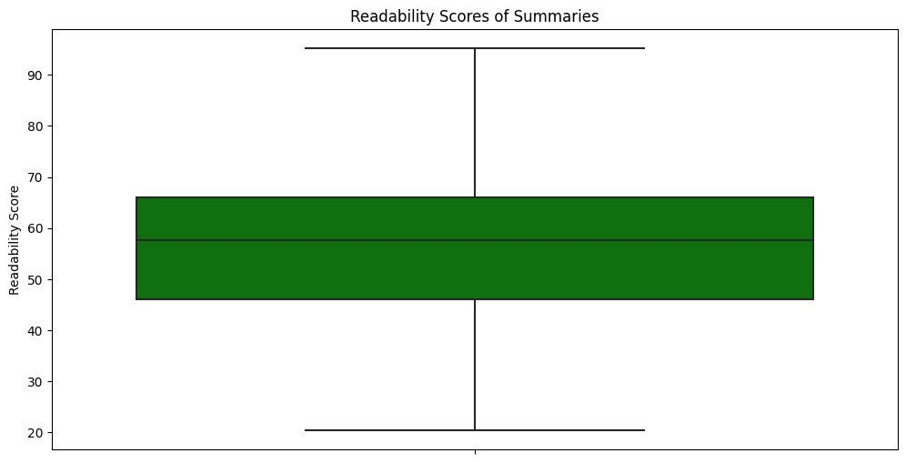
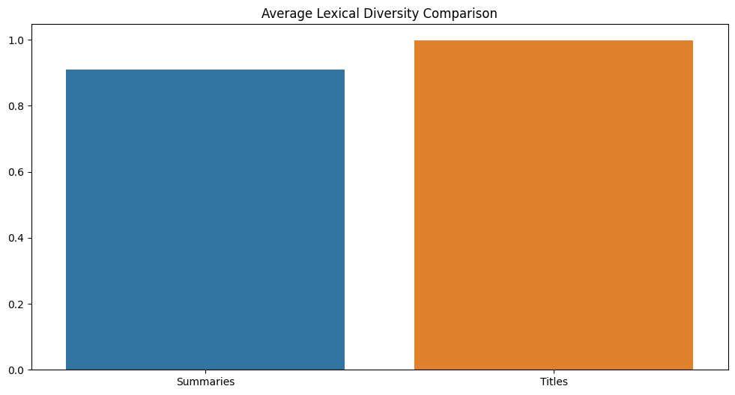
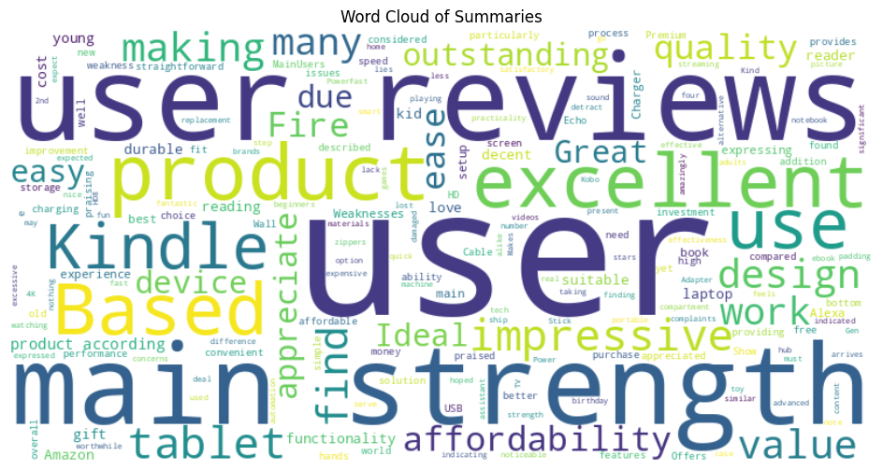
Prompt engineering on Mistral Key Insights and Final Evaluation Results
Summary and title quality assessments:
Turning reviews into actionable insights through AI-powered sentiment clustering and summarization.

Slide 13
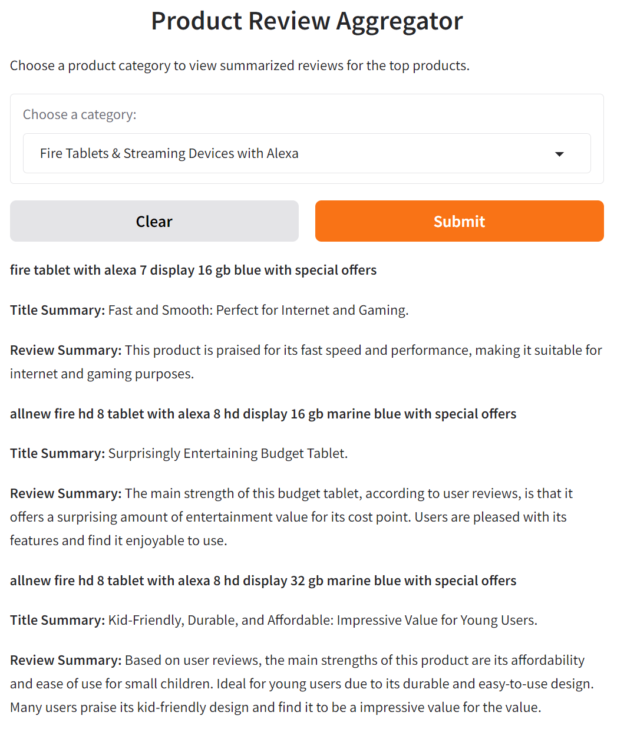
Takeaway
From useless reviews to a plethora of insights about your products, competitors, users, user behavior…
Efficient combination of models for effective handling of tasks
Challenges:
Limited data quality limits the output of the models. Specially in clustering
What’s next?
Integrate all models to be plug and play
Generation of more in depth articles, with not only summaries but a proper article comparing products.
https://github.com/Salvacat/SenCluSum-AI
Turning reviews into actionable insights through AI-powered sentiment clustering and summarization.

Slide 14
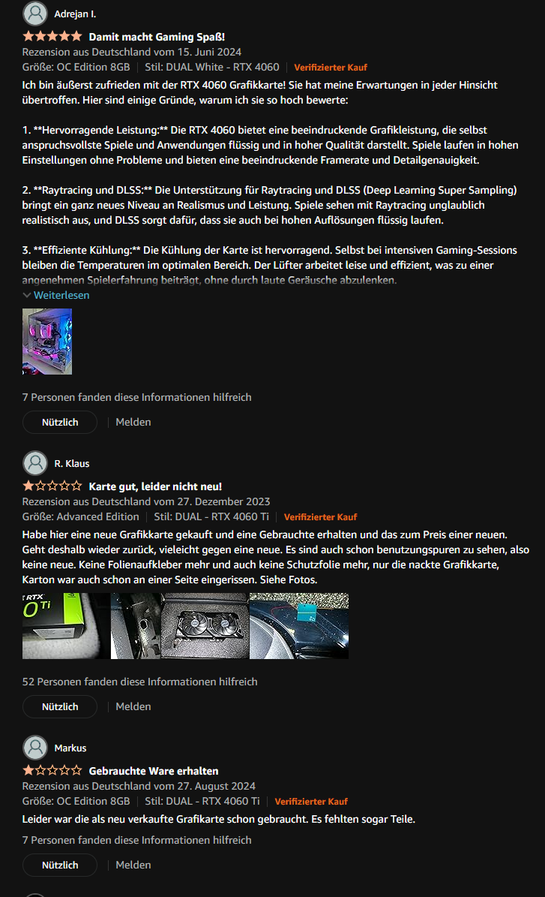
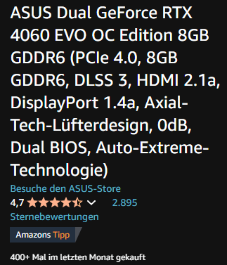
What is your story?
Thousands of reviews
But no use for them
Only focusing on getting a higher rating
Review text might not match the sentiment of the rating
Traditional categories
Might not reflect the true competitors as they are too vague
Lack of insights from real competitors
Impossible to sort through all reviews
Untapped potential of user feedback
Highlights
Where to improve
What's not working
How and who are your customers
Turning reviews into actionable insights through AI-powered sentiment clustering and summarization.

